Slide 1
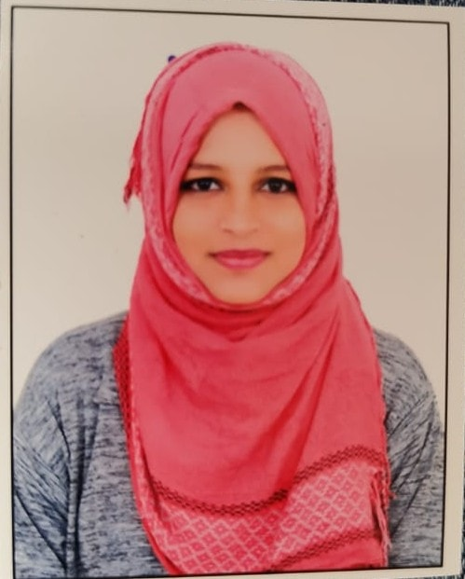





Safiya Najath S
Skills & Competencies
Professional Career
Java
Python
SQL
HTML/CSS
PHP
Agile
Tools :
IntelliJ
VS code
Jupyter Notebook
Completed my internship using python from machine learning.
I have undergone competency training in DevOps-Ansible,Dockers,SAP-Basis,
Automation Testing-Selenium,TestNG,Maven.
Working as Software Engineer for Bristlecone India Ltd , Bangalore September 2021 to till date.
Associate Consultant
As an ambitious and honest individual, I am often recognized for my commitment.I am looking forward to improve on my skills and learn new technologies.
Project Experiences
Education & Certification
RENAISSANCE LEARNING
Renaissance learning partners with educators to reach new levels of student performance, empowering teachers with data to serve the whole child.
They bring holistic data and collaborative instructional tools together
I have been working for the Illuminate project for nearly 3 years as of now.
I have been a part of the Data Team, working as a PHP developer on the backend.
As a Data Team developer my role has been to manage the data imports and extracts.
While working on this project I have helped the clients by solving various bugs and issues at the Data end.
I have also integrated new functionalities for Data imports.
Education:
Bachelor of Engineering (ISE).
Certifications/Training:Completed (DevOps- Ansible , Dockers ,SAP-Basis, Automation Testing- Selenium, TestNG, Maven) Training.​
Online Platform
GitHub:
https://github.com/SafiyaNajath
Bcone: ​
Safiyanajath.s@bristlecone.com​
​
Industries
Information Technology
© 2019 Bristlecone. All rights reserved.
1

